Slide 1
Today:
Keras framework
ResNet
Ex4

Slide 2
Keras Framework
Defining Model and Layers
Compiling and Training
Saving and Loading
Prediction

Slide 3
Keras & Tensorflow
TensorFlow is a general low-level machine learning library by Google.
Keras is a framework for neural networks that is build on top of Tensorflow. It has a much more friendly API.
(PyTorch is another popular framework by Facebook)

Slide 4
Keras models
Sequential : only feed forward networks, very limited.
Functional (Model) : can have many inputs and outputs, can brunch, Much more versatile.

Slide 5
Keras models
Sequential : only feed forward networks, very limited.
Functional (Model) : can have many inputs and outputs, can brunch, Much more versatile.

Slide 6
Functional model
Model is defined by the input and output layers.
The input of each layer is a keras layer (a tensor)
Example:
import tensorflow as tf
from tensorflow.keras import layers
input_layer = tf.keras.Input(shape=(21, 21,3), name="InputLayer")
conv2d_layer = layers.Conv2D(32, (5,5),padding='same')(input_layer)
conv2d_layer = layers.Conv2D(32, (5,5),padding='same')(conv2d_layer)
last_layer = layers.Conv2D(32, (5,5),padding='same')(conv2d_layer)
model = tf.keras.Model(input_layer, last_layer, name="my_network")

Slide 7
Functional model
The model can take many inputs and give many outputs.
Example:
import tensorflow as tf
from tensorflow.keras import layers
input_1 = tf.keras.Input(shape=(21, 21,3))
input_2 = tf.keras.Input(shape=(10, 10,3))
conv2d_1 = layers.Conv2D(32, (5,5),padding='same')(input_1)
conv2d_2 = layers.Conv2D(32, (5,5),padding='same')(input_2)
model = tf.keras.Model([input_1, input_2 ], [conv2d_1, conv2d_2])

Slide 8
Keras layers
Input layer: defines the input of the network, in some cases (Vision for example) we want the option to get any input size.
If our network for example only uses Convolutional layers and no Fully connected layers we can use:
Input_layer = tf.keras.Input(shape=(None, None,3))

Slide 9
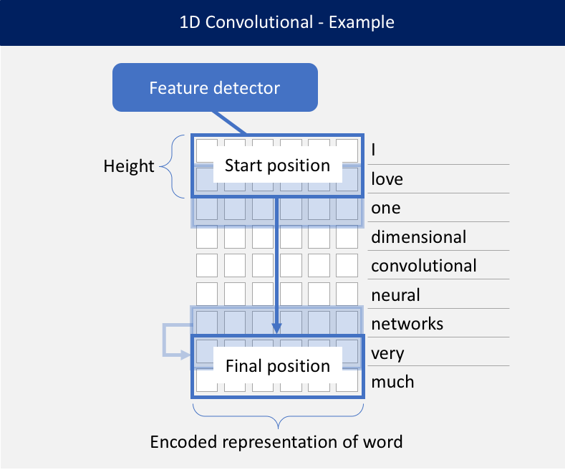
Keras layers
1D convolution: This layer creates a convolution kernel that is convolved with the layer input over a single spatial dimension to produce a tensor of outputs.

Slide 10
Keras layers
1D convolution: This layer creates a convolution kernel that is convolved with the layer input over a single spatial dimension to produce a tensor of outputs.
Example:
input = tf.keras.Input(shape=(10, 20))
conv1d_layer = layers.Conv1D(32, 3, padding='same')(input_layer)
what is the output size?

Slide 11
Keras layers
1D convolution: This layer creates a convolution kernel that is convolved with the layer input over a single spatial dimension to produce a tensor of outputs.
Example:
input = tf.keras.Input(shape=(10, 20))
conv1d_layer = layers.Conv1D(32, 3, padding='same')(input_layer)
what is the output size?
(10, 32)

Slide 12

Keras layers
2D convolution: This layer creates a convolution kernel that is convolved with the layer input to produce a tensor of outputs.

Slide 13
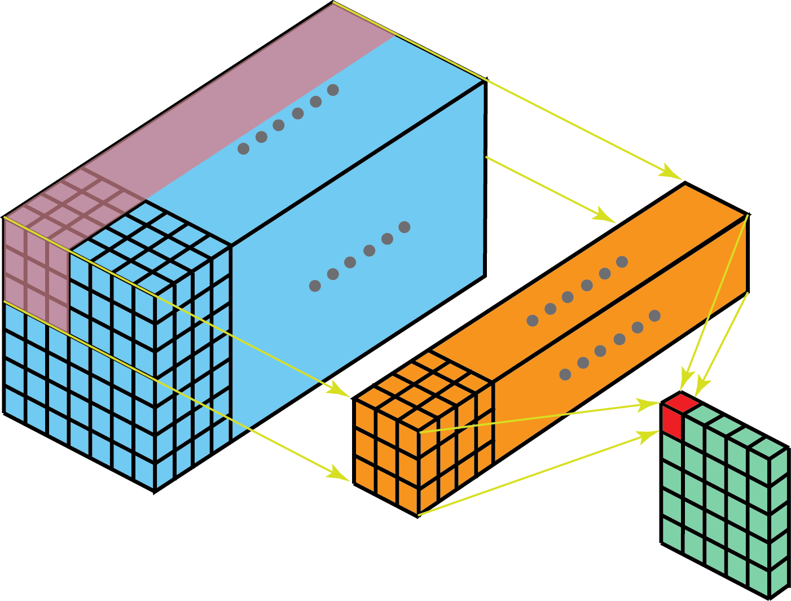
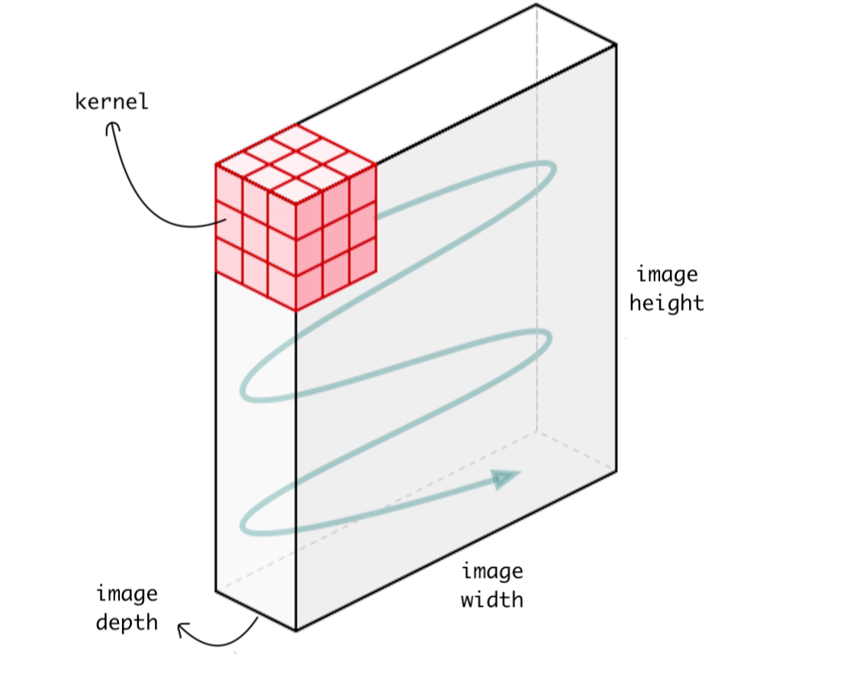
Keras layers
2D convolution: This layer creates a convolution kernel that is convolved with the layer input to produce a tensor of outputs.

Slide 14
Keras layers
2D convolution: This layer creates a convolution kernel that is convolved with the layer input to produce a tensor of outputs.
Example:
input = tf.keras.Input(shape=(10, 20, 3))
conv2d_layer = layers.Conv2D(64, (5,5), padding='same')(input_layer)
what is the output size?

Slide 15
Keras layers
2D convolution: This layer creates a convolution kernel that is convolved with the layer input to produce a tensor of outputs.
Example:
input = tf.keras.Input(shape=(10, 20, 3))
conv2d_layer = layers.Conv2D(64, (5,5), padding='same')(input_layer)
what is the output size?
(10, 20, 64)

Slide 16

Keras layers
2D convolution: This layer creates a convolution kernel that is convolved with the layer input to produce a tensor of outputs.
Dilation:

Slide 17
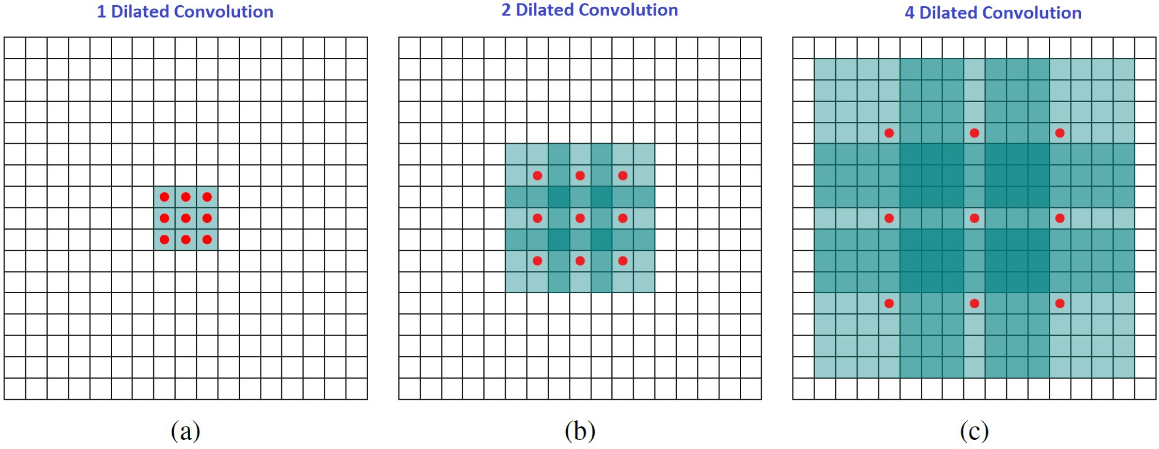
Keras layers
2D convolution: This layer creates a convolution kernel that is convolved with the layer input to produce a tensor of outputs.
Dilation:

Slide 18

Keras layers
Activation: Preforms a None linear function on the input.
(Relu, Softmax, ELU, Tanh, Sigmoid and more…).

Slide 19
Keras layers
Activation: Preforms a None linear function on the input.
(Relu, Softmax, ELU, Tanh, Sigmoid and more…).
Example:
input = tf.keras.Input(shape=(10, 20, 3))
conv2d_layer = layers.Conv2D(64, (5,5), padding='same')(input_layer)
activation_layer = layers.Activation(“relu”)(conv2d_layer)
# or
activation_layer = layers.RelU()(conv2d_layer)
# or
activation_layer = layers.Conv2D(64, (5,5), padding='same’,activation=‘relu’)(input_layer)

Slide 20
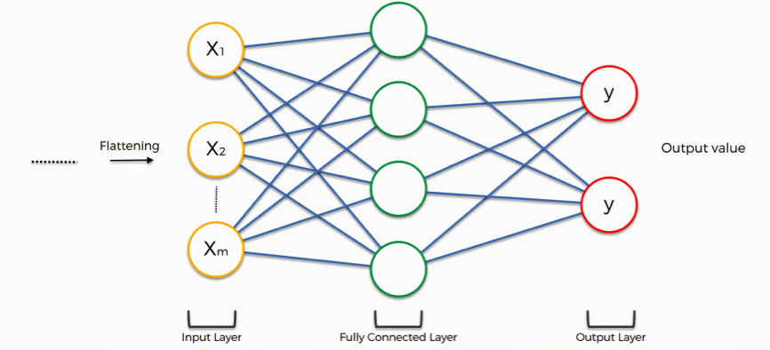
Keras layers
Dense (Fully connected layer).
MaxPooling1D, MaxPooling2D.
AveragePooling1D, AveragePooling2D.
Attention layers.
Conv3D
Reshaping layers (Permute)
BatchNormalization
Merging layers (Add)
Regularization layers (Dropout)
And many more…

Slide 21
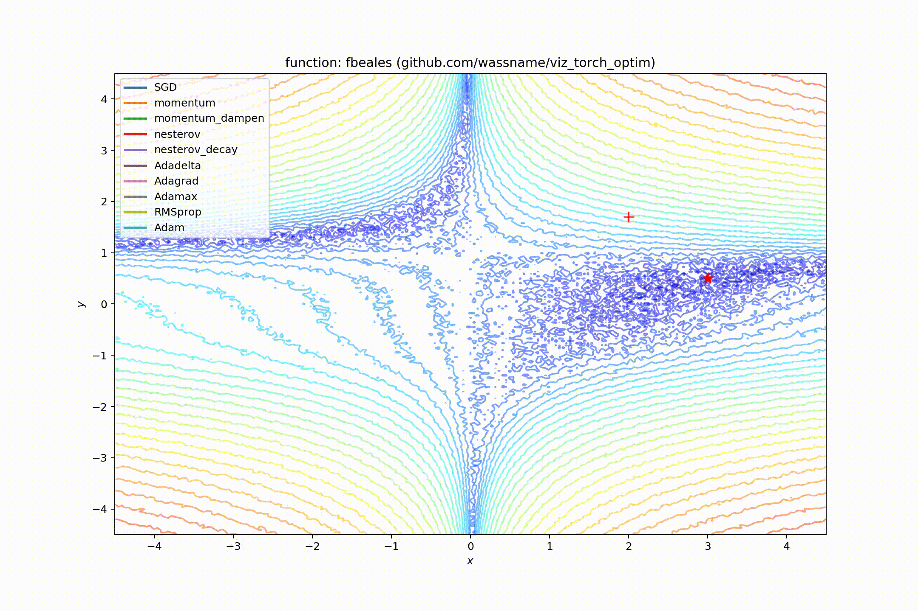
Compiling
choosing the loss function (MSE loss, Categorical Cross Entropy…)
Choosing the optimizer algorithm (SGD, Adam…)
and the learning rate (step size).

Slide 22
Compiling
choosing the loss function (MSE loss, Categorical Cross Entropy…)
Choosing the optimizer algorithm (SGD, Adam…)
and the learning rate (step size).
Example:
model = tf.keras.Model(in, out)
my_optimizer= tf.keras.optimizers.Adam(learning_rate=0.001)
model.compile(optimizer=my_optimizer, loss=“categorical_crossentropy")

Slide 23
Training
training the model on labeled data (X,Y).
Choosing number of epochs and the batch size.
epochs- number of times we are going over the entire training data
batch size- number of samples in each batch
Example:
history = model.fit(X, Y, epochs=100, batch_size=32)
history = model.fit([X1,X2], [Y1,Y2], epochs=100, batch_size=32)
can also receive validation_split/validation_data parameters.
and callbacks parameters.

Slide 24
Predicting
Make prediction on new samples
Example:
Y_pred = model.predict(X)
(X has to be a batch of inputs – for single input use batch size of 1)

Slide 25
Saving and Loading
Saving and loading our trained model (because training can take very long!)
Example:
model.save(“my_path")
model = tf.keras.models.load_model(“my_path")

Slide 26
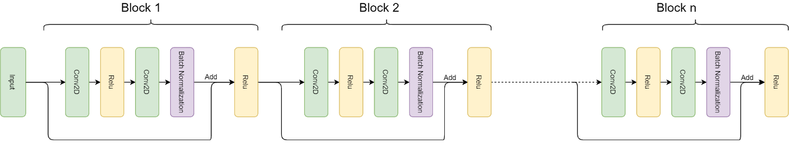
ResNet
We add (element wise) the input of each residual block to its output.
Deeper networks, Faster convergence, less over-fitting.
-A block can contain any type of layers (and any number of them)-

Slide 27
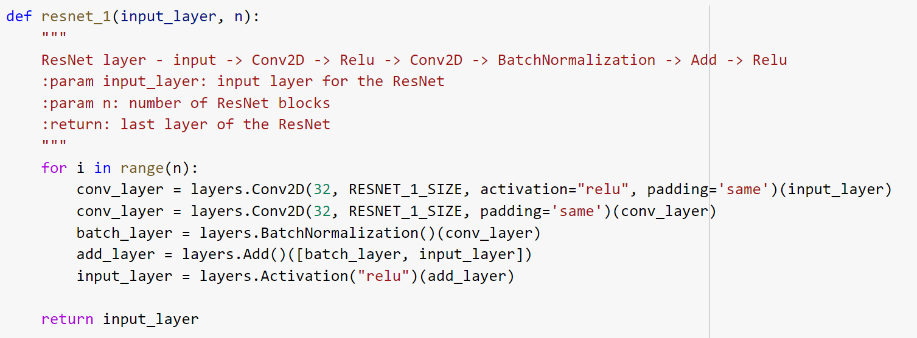
ResNet
We add (element wise) the input of each residual block to its output.
Deeper networks, Faster convergence, less over-fitting.

Slide 28
Ex4
Using neural networks in order to predict nanobody CDR3 structure

Slide 29
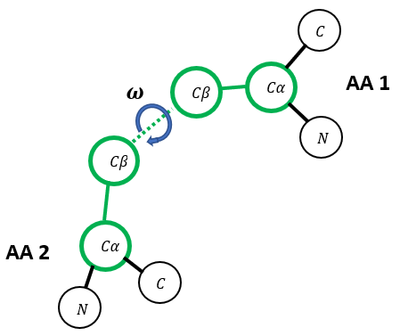
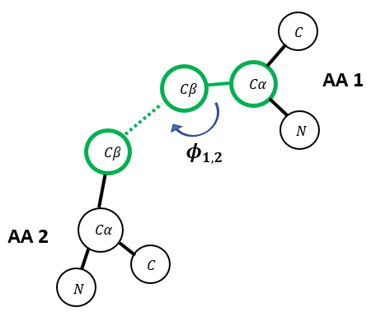
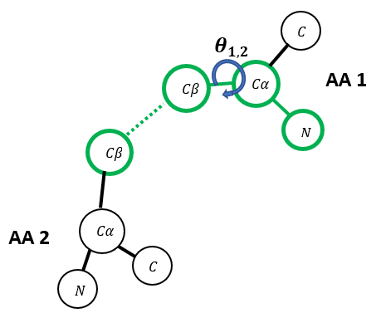
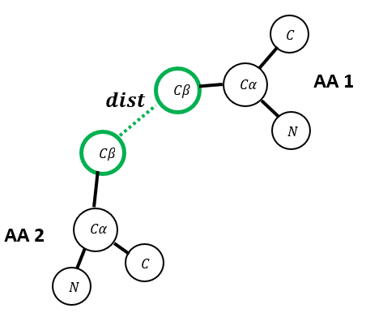
Ex4
has 3 parts:
1. Processing the data - from PDB files to one-hot encoding (X) and geometrical constraints (Y). Most of this part is implemented for you.

Slide 30
Ex4
has 3 parts:
1. Processing the data - from PDB files to one-hot encoding (X) and geometrical constraints (Y). Most of this part is implemented for you.

Slide 31
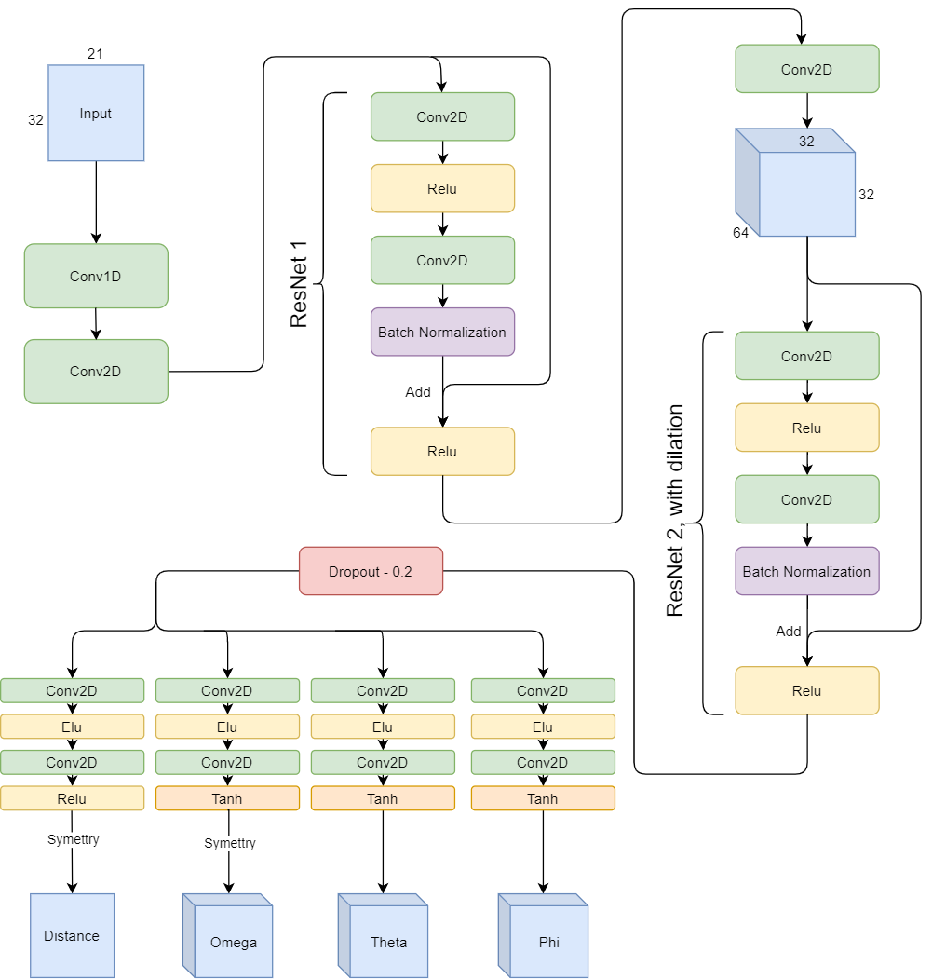
Ex4
has 3 parts:
2. Building and training the network.
The main thing you have to do is
choose some of the parameters
for the network.

Slide 32
Ex4
has 3 parts:
2. Building and training the network.
The main thing you have to do is
choose some of the parameters
for the network.

Slide 33
Ex4
has 3 parts:
3. Predicting PDB 5jds (from Ex3), converting the output to Rosetta
constraints file (implemented for you).
Using the constraints in order to model the CDR3 loop (same as Ex3).

Slide 34
Further reading
Keras guide - https://keras.io/
Stanford Neural Network course (mainly vision) – search cs231n on YouTube (spring 2017)

